Slide 1
Public Health Implications of Water Supply Improvements
Did Environmental Engineers save the world?

Slide 2
The greatest obstacle to discovery is not ignorance – it is the illusion of knowledge
- Daniel J. Boorstin

Slide 3
Public Health
Environmental Engineers help protect communities from waterborne disease
Water related Public Health is complex
Chlorine may be overrated
Hygiene and education matters
Household infrastructure matters

Slide 4
The role of Water Supply, Sanitation, and Hygiene (WASH)
Contribute significantly to mortality and morbidity on the global level
Have an enormous influence on U5MR (under 5 mortality rate)
What is the effect of safe drinking water?

Slide 5
Mills-Reincke Phenomenon
‘…. the purification of polluted public water-supplies reduces the general death-rate much more than it would be reduced by the saving of deaths from the commonly recognized water-borne disease, typhoid fever and Asiatic cholera alone.’
Sedgwick WT, MacNutt JS. On the Mills-Reincke phenomenon and Hazen's theorem concerning the decrease in mortality from diseases other than typhoid fever following the purification of public water-supplies. J.Infect.Dis. 1910; 7 : 489-564.
This is the “Environmental Engineers Saved the World” Hypothesis.

Slide 6
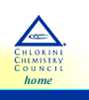
U.S. Typhoid Fever Mortality
Chlorination was begun in Jersey City, N.J., in 1908. Adoption by other cities and towns across the US soon followed and resulted in the virtual elimination of waterborne diseases such as cholera, typhoid, dysentery and hepatitis A
35
Chlorination begins in Jersey City
30
25
20
deaths per 100,000
15
10
5
0
1900
1910
1920
1930
1940
1950
year
Chlorine saved the day
Salmonella typhi
oral (e.g., ingestion of contaminated food, fecal particles, or contaminated water).
Notes:
Water Res. 2002 Sep;36(15):3874-88.
Role of disinfection in suppressing the spread of pathogens with drinking water: possibilities and limitations. Schoenen D. Hygiene-Institut, Universitatsklinikum Bonn, Sigmund-Freud-Strasse 25, 53105 Bonn, Venusberg, Germany. dirk.schoenen@ukb.uni-bonn.de

Slide 7
Chlorine Cause and Effect: What else would you like to know…
What was the mortality rate before the introduction of chlorine?
When did other cities adopt chlorination?
How did the mortality rate change for cities when they began chlorinating?
What other changes were occurring during the 1900s that may have influenced mortality?

Slide 8
Disease rates as measures of efficiency
“The final criterion of the efficiency of a purification plant is the absence or prevalence in the community of water-borne diseases. Typhoid fever being the most typical and widespread of such diseases, statistics of its prevalence are of much significance. Prior to the general introduction of purification works, the typhoid death rate was invariably high in many of our large cities drawing their supply from polluted rivers and lakes. Most of these cities are now supplied with satisfactory water, and many records could be given showing the marked effect of water treatment on the typhoid rate. The following data for the cities of New Orleans, Pittsburgh and Cincinnati will suffice.”
Public Water-Supplies by Turneaure, Russell, Mead, Baker. John Wiley & Sons (1924) pages 430-431.
Notes:
Public Water-Supplies by Turneaure, Russell, Mead, Baker. John Wiley & Sons (1924)

Slide 9
Evidence for a Causal Link: New Orleans, Pittsburgh, Cincinnati
Pittsburgh, Cincinnati and New Orleans were used as evidence of the efficacy of filtration
Public Water-Supplies by Turneaure, Russell, Mead, Baker. John Wiley & Sons (1924)

Slide 10
Let’s look at all the data using log scale (showing improvement ratio)
Notes:
The Role of Public Health Improvements in Health Advances:
The 20th Century United States
David Cutler (dcutler@harvard.edu)1,2 and Grant Miller (nmiller@fas.harvard.edu) 1
https://link.springer.com/content/pdf/10.1353%2Fdem.2005.0002.pdf
February 2004
1Harvard University;
2National Bureau of Economic Research (NBER).
http://paa2004.princeton.edu/download.asp?submissionId=40507

Slide 11
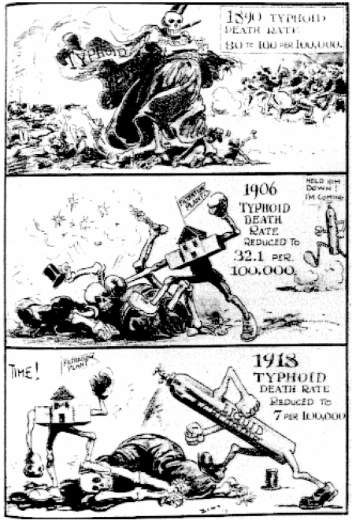
Correlation between Water Supply Improvements and Public Health?
A causal link?
Filtration
Chlorination
Delayed response?
No link?
US 1900 – 1940 interpretation?
Notes:
Cartoon by Zim, 1919
http://paa2004.princeton.edu/download.asp?submissionId=40507

Slide 12
Trying to Understand the Data
“The steady reduction… is probably due in part to improved operation and in part to the gradual elimination of the disease from the community and so removing sources of contamination.”
“It should be noted that typhoid fever is frequently traced to other causes than the water-supply,…”
What else was happening?
Public Water-Supplies by Turneaure, Russell, Mead, Baker. John Wiley & Sons (1924)

Slide 13
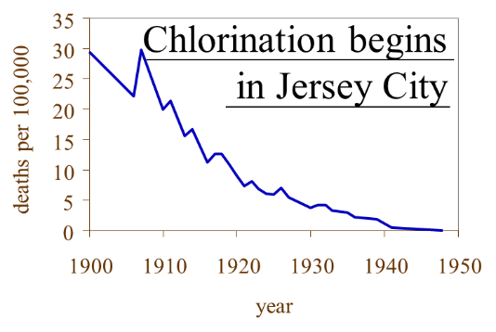
Reading the Typhoid Data
How long did it take for typhoid incidence to decrease? _____________
If typhoid was waterborne how long should it have taken for filtration and chlorination to eliminate typhoid? _____________
How does milk get typhoid?
30 to 40 years
A few weeks
Human excrement (milker’s hands?)
Since S. Typhi and S. Paratyphi A are found only in human hosts, the usual sources of these organisms in the environment are drinking and/or irrigation water contaminated by untreated sewage.
Notes:
Onset: Generally 1 to 3 weeks, but may be as long as 2 months after exposure.
http://www.fda.gov/downloads/Food/FoodborneIllnessContaminants/UCM297627.pdf
Since S. Typhi and S. Paratyphi A are found only in human hosts, the usual sources of these organisms in the environment are drinking and/or irrigation water contaminated by untreated sewage.

Slide 14
My Typhoid Hypothesis
The reduction was not due to a one time centralized change
Not due to filtration
Not due to chlorination
Was due to changes that occurred at different times throughout the population
Improved hygiene
Installation of toilets in bathrooms with sinks to wash hands and toilet paper
Education encouraging hand washing
Better food handling practices
Milk pasteurization
Refrigeration
Public Health Education and medical care
Typhoid was likely not waterborne
Notes:
The reduction in typhoid occurred over a 40 year period
The reduction was not due to a one time centralized change
Not due to filtration
Not due to chlorination
Was due to changes that occurred at different times throughout the population
Improved hygiene
Installation of toilets in bathrooms with sinks to wash hands
Education encouraging hand washing
Better food handling practices
Farmers washed their hands after they used the bathroom and before they milked the cows
Refrigeration

Slide 15
Typhoid isn’t the only waterborne disease!
And most of the waterborne illnesses don’t result in death!
Most waterborne disease doesn’t even result in a visit to a health clinic

Slide 16
Causes of diarrhoea according to ‘Diseases of children’
1889
1899
Sour milk
Unripe fruit
Inhalation of sewer gas
Emanations from the soil
‘no doubt that the immediate cause is an infection of the alimentary canal, by …bacteria contained in milk or other forms of food’
Powerlessness!
Empowerment
Notes:
http://www.phpc.cam.ac.uk/mst/phtop/transition_in_west_mst_oct_02_web.ppt

Slide 17
Changes recommended: public health campaign
Breast feed
Boil cow’s milk, sterilize bottles
Protect infants from persons known to be ill
Control flies
Wash hands
You can improve your health!
Notes:
http://www.phpc.cam.ac.uk/mst/phtop/transition_in_west_mst_oct_02_web.ppt

Slide 18
Maybe we are helping to save the world from stunted growth
Of the 555 million preschool children in developing countries, 32% are stunted and 20% are underweight.¹
A key cause of child undernutrition is a subclinical disorder of the small intestine known as tropical enteropathy
Caused by faecal bacteria ingested in large quantities
Notes:
http://onlinelibrary.wiley.com/doi/10.1111/nyas.12330/full#nyas12330-bib-0022

Slide 19
Fecal-Oral Pathways
Hygiene
Water treatment
Sanitation
Pathogen source
Sanitation method
Environment
Transport
washing
Drinking water
Human excreta
Dry sanitation involving reuse
Hands
Surface water
Waterborne sewage
Water
Ground water
Oral
Non recycling latrines
Crops
Animal excreta
Food
Land application
Flies
Soil

Slide 20
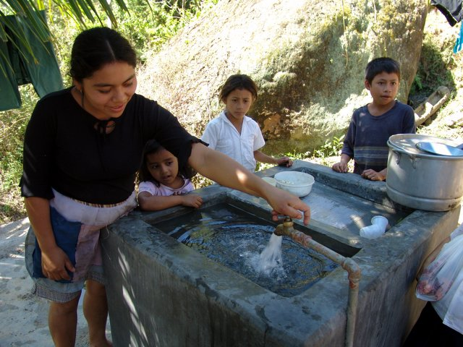

Slide 21
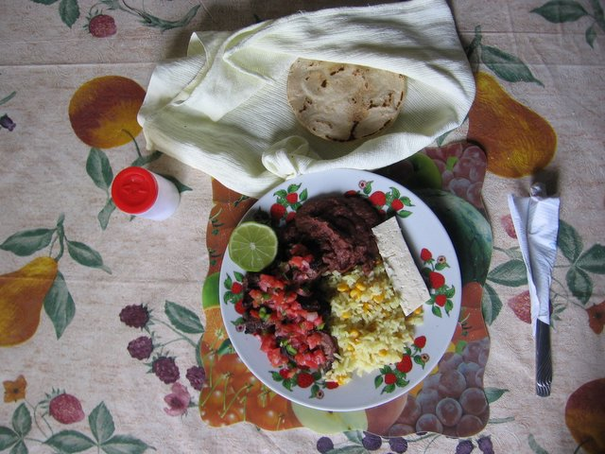

Slide 22
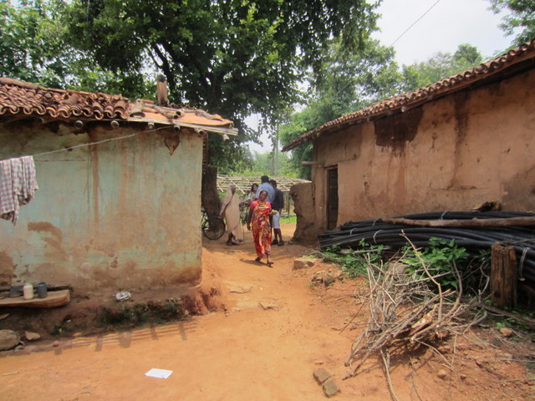

Slide 23
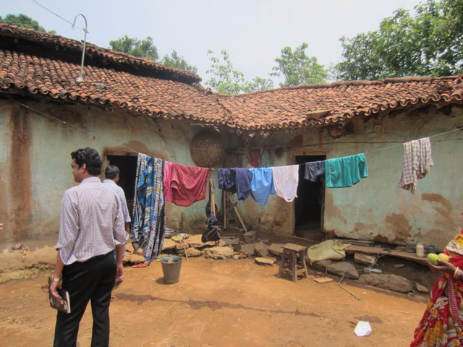
Notes:
Did they wash this clothing at home or at the well?

Slide 24
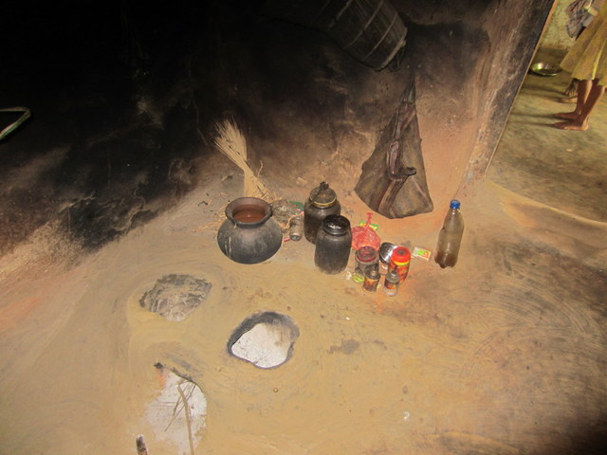
Notes:
The kitchen

Slide 25
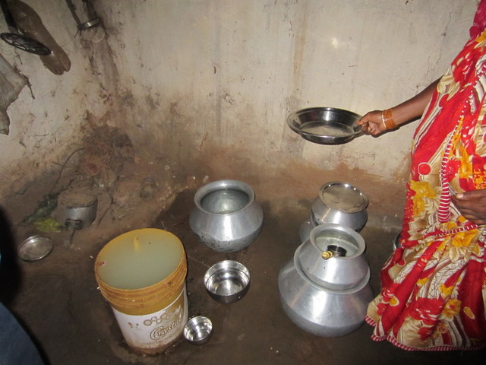
Notes:
Household water infrastrucutre

Slide 26
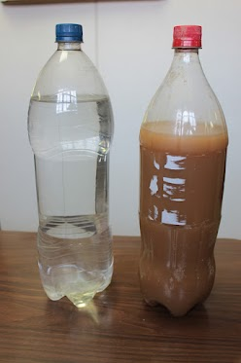
Improved or Safe?
Improved
Safe
Came out of a pipe that was near the town.
Doesn’t meet the Sustainable Development Goal!!!
Was treated to remove contamination and won’t make you sick
Notes:
The bottle on the left is improved water. What exactly is this dirty water good for? Perhaps watering your garden! What people really want is the same thing that you and I want. We want safe water on tap.

Slide 27

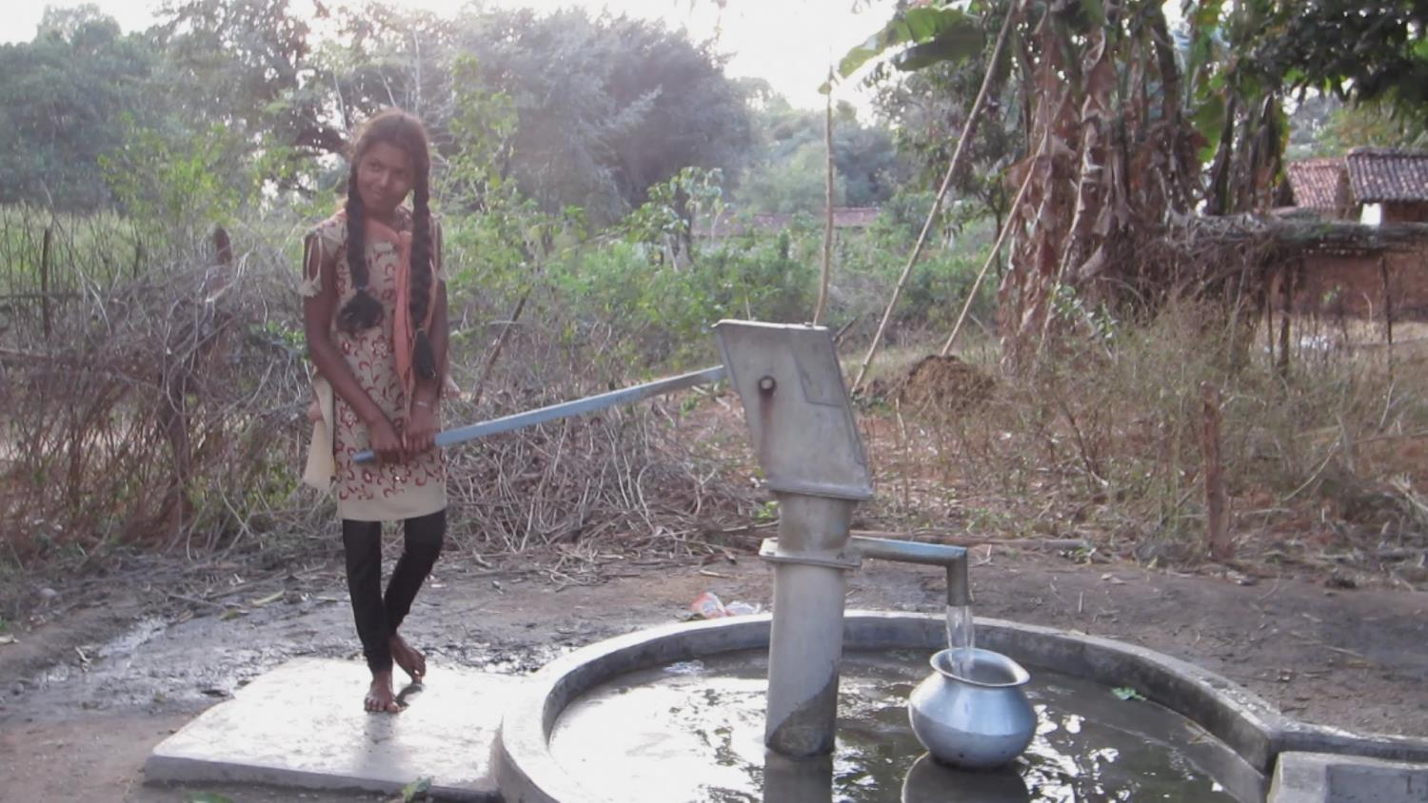

Improved
Safe
Convenient
Notes:
How would you wash your hands?
Why is the water spout as far away as possible from the handle?

Slide 28
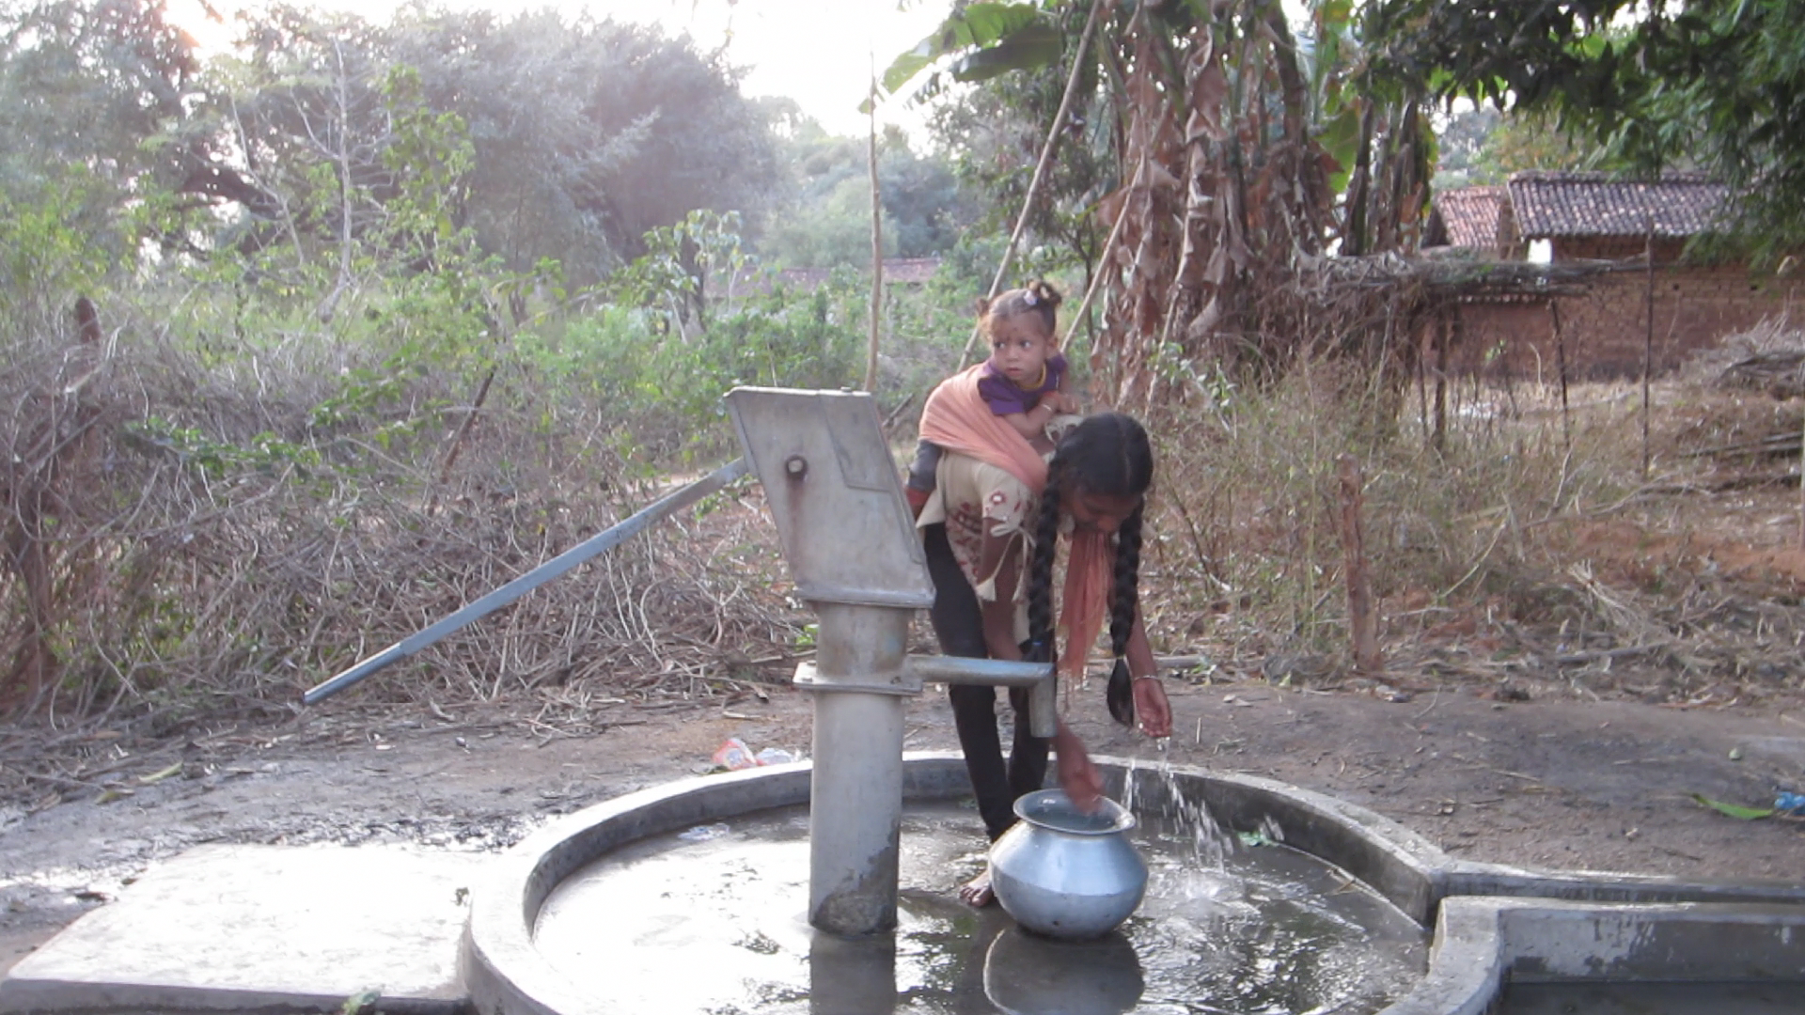

Slide 29
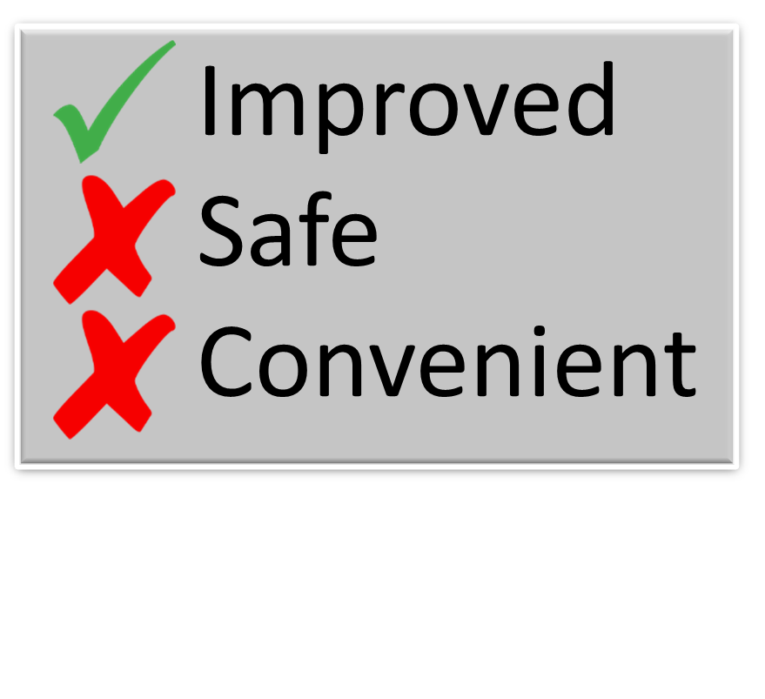
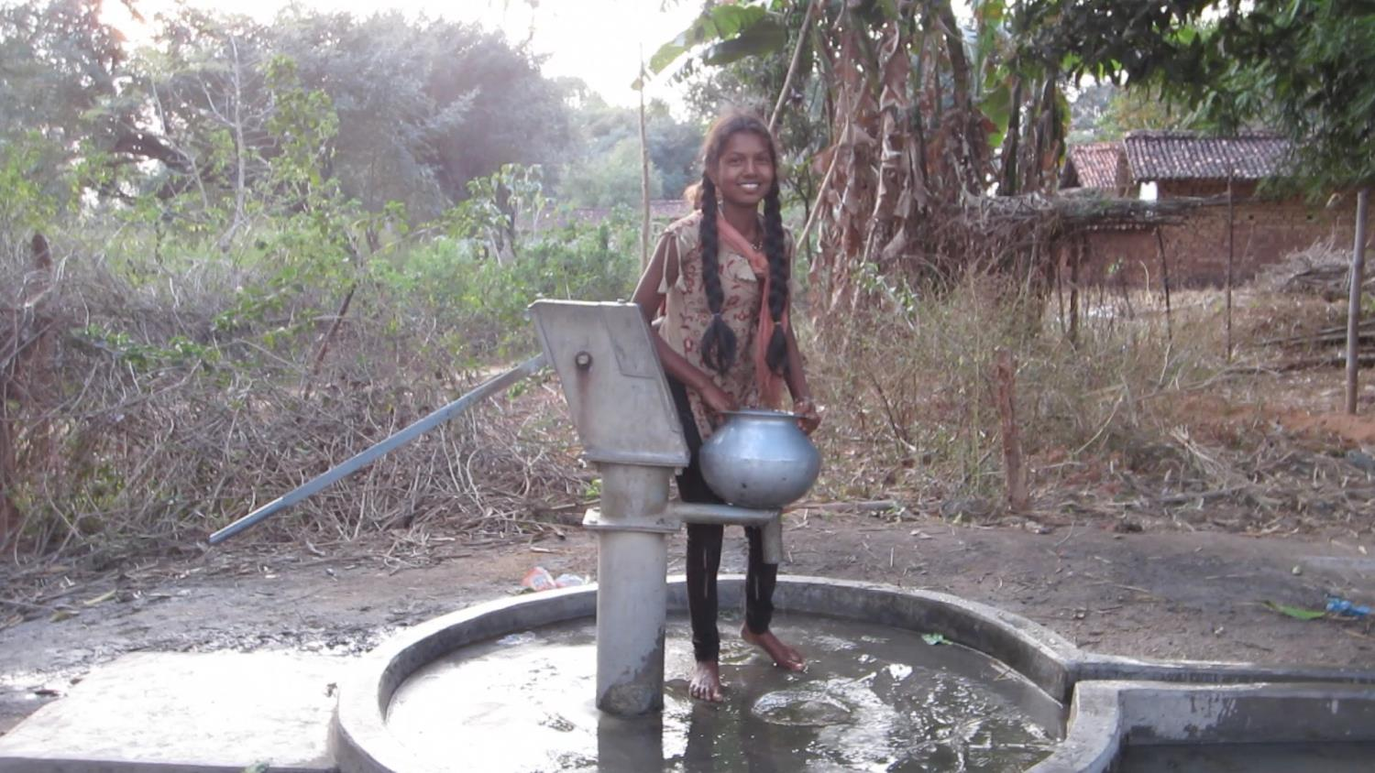

Slide 30
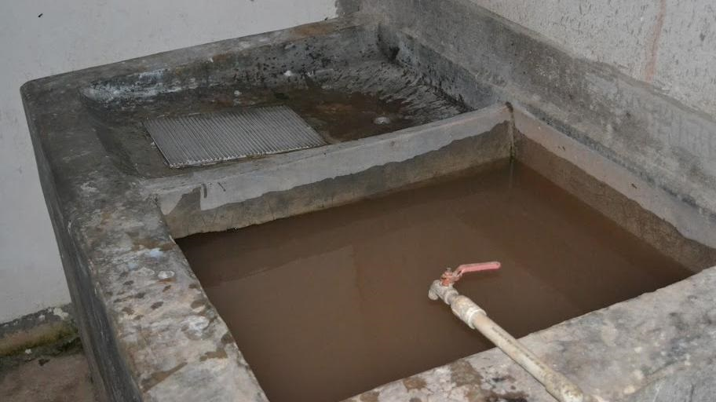
Improved
Safe
Convenient

Slide 31
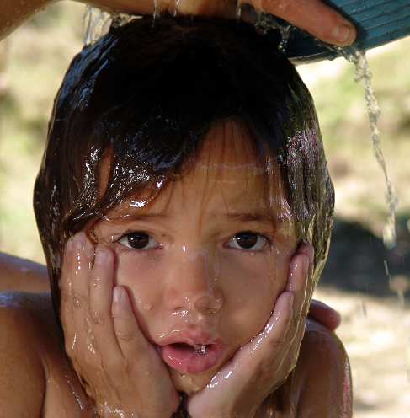
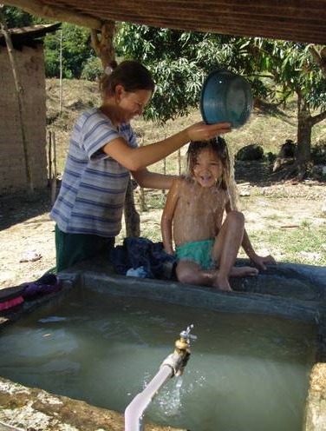

Slide 32
The customer wanted safe water on tap
What do people want? (see SDG 6)
Reliable, easy access to plenty of safe, aesthetically pleasing water
Judge based on __________________________
Will they be willing to pay for and maintain more expensive infrastructure to have aesthetically pleasing water? ________________________
The challenge of invisible contaminants
The challenge of small settlements
looks and taste/smell
YES! (at least in many cases)

Slide 33
Should we measure health outcomes in Honduran communities before building more AguaClara plants?

Slide 34
Should we measure health outcomes in US communities before building more Water Treatment plants?

Slide 35
Safe water infrastructure extends from watershed to watershed
Watershed protection to minimize erosion and reduce contamination
Water treatment to remove contaminants
Safe water transport to households
Household infrastructure (sinks)!
Waste water collection
Waste water treatment and return to the environment

Slide 36
Creative solutions needed for villages
In cities water distribution systems and storage tanks are designed for fire protection
In villages fire protection may not be as critical
Household storage would enable a lower cost, smaller diameter, distribution system
Households could manage their water consumption

Slide 37
Creative solutions needed for cities
Consider smaller scale wastewater collection and treatment for local reuse
Reuse wastewater for lower quality water needs
Flush toilets
Fire protection pond
irrigation
Reduce pumping costs with distributed/decentralized wastewater collection, treatment, and reuse
Watch out for unintended consequences!

Slide 38
Summary
Fecal oral routes are complicated and thus may require multiple interventions
Safe water
Household infrastructure for washing and safe water handling
Safe food handling
Safe waste disposal
We need creative environmental engineering solutions as
populations continue to grow
climate changes
water resources are stretched

